Slide 1
Cost of Production

Slide 2
THE VARIOUS MEASURES OF COST
Everywhere that production goes, costs follow close behind like a shadow.
Costs of production may be divided into fixed costs and variable costs.
Fixed costs are those costs that do not vary with the quantity of output produced.
Variable costs are those costs that do vary with the quantity of output produced

Slide 3
  Fixed Cost & Variable Cost
$ Cost
TC
  C(Q) = FC + VC
  Total Cost
  =Fixed Cost + Variable Cost
VC(Q)
FC
Q

Slide 4

Figure 4 Thirsty Thelma’s Total-Cost Curves
Total Cost
$15.00
Total-cost curve
14.00
13.00
12.00
11.00
10.00
9.00
8.00
7.00
6.00
5.00
4.00
3.00
2.00
1.00
0
1
2
3
4
5
6
7
8
9
10
Quantity
of Output
(glasses of lemonade per hour)
Copyright © 2004 South-Western

Slide 5
From the Production Function to the Total-Cost Curve
The relationship between the quantity a firm can produce and its costs determines pricing decisions.
The total-cost curve shows this relationship graphically.

Slide 6

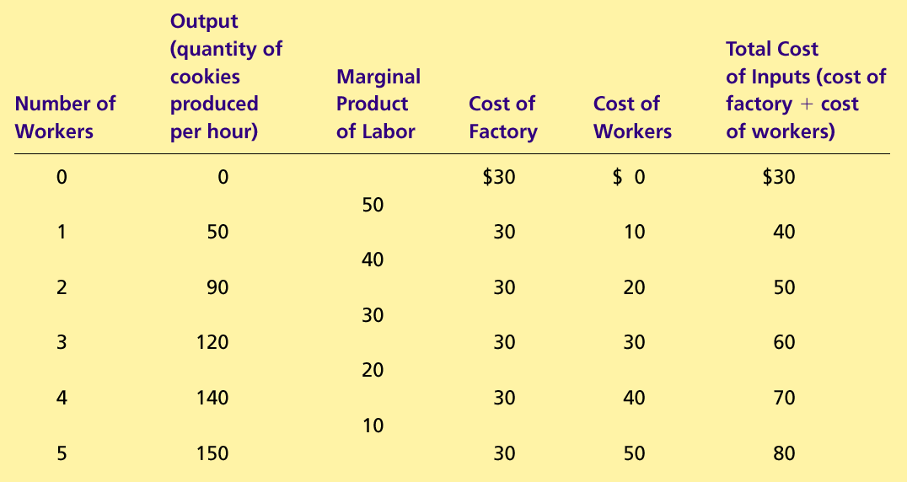
Table 1 A Production Function and Total Cost: Hungry Helen’s Cookie Factory
Copyright©2004 South-Western

Slide 7
Figure : Hungry Helen’s Total-Cost Curve
Total
Cost
$80
Total-cost
curve
70
60
50
40
30
20
10
0
10
20
30
40
50
60
70
80
90
100
110
120
130
140
150
Quantity
of Output
(cookies per hour)
Copyright © 2004 South-Western

Slide 8
Average Costs
  Average costs can be determined by dividing the firm’s costs by the quantity of output it produces.
  The average cost is the cost of each typical unit of product.
  Average Fixed Costs (AFC)
  Average Variable Costs (AVC)
  Average Total Costs (ATC)
  ATC = AFC + AVC

Slide 9
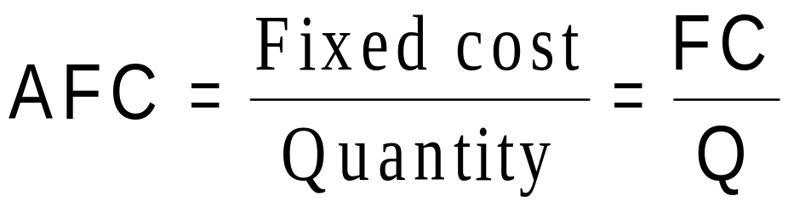
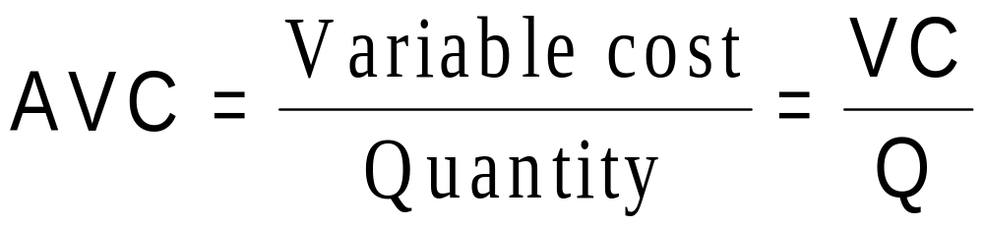
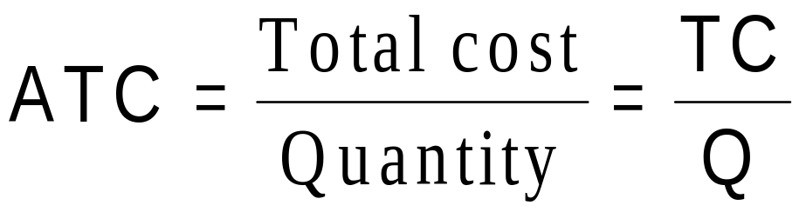
Average Costs

Slide 10
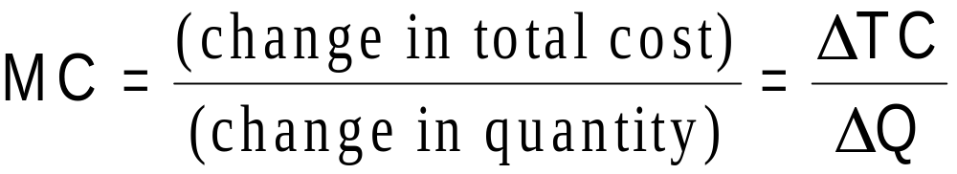
Marginal Cost
  Marginal cost (MC) measures the increase in total cost that arises from an extra unit of production.
  Marginal cost helps answer the following question:
    How much does it cost to produce an additional unit of output?

Slide 11
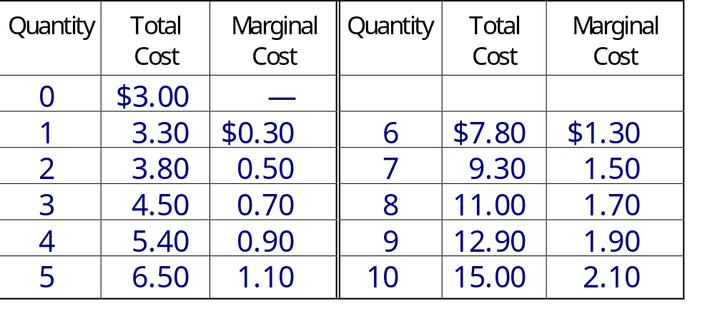
Marginal Cost

Slide 12
Cost Curves and Their Shapes
Marginal cost rises with the amount of output produced.
  This reflects the property of diminishing marginal product.

Slide 13
Figure 5 : Marginal-Cost Curves
Costs
$3.50
3.25
3.00
2.75
2.50
2.25
MC
2.00
1.75
1.50
1.25
1.00
0.75
0.50
0.25
0
1
2
3
4
5
6
7
8
9
10
Quantity
of Output
(glasses of lemonade per hour)
Copyright © 2004 South-Western

Slide 14
Cost Curves and Their Shapes
Relationship between Marginal Cost and Average Total Cost
  Whenever marginal cost is less than average total cost, average total cost is falling.
  Whenever marginal cost is greater than average total cost, average total cost is rising.
  The marginal-cost curve crosses the average-total-cost curve at the efficient scale.
    Efficient scale is the quantity that minimizes average total cost.

Slide 15
Figure :Average-Cost and Marginal-Cost Curves
Costs
$3.50
3.25
3.00
2.75
2.50
2.25
MC
2.00
1.75
1.50
ATC
1.25
1.00
0.75
0.50
0.25
0
1
2
3
4
5
6
7
8
9
10
Quantity
of Output
(glasses of lemonade per hour)
Copyright © 2004 South-Western

Slide 16
Cost Curves and Their Shapes
The average total-cost curve is U-shaped.
At very low levels of output,average total cost declines as output increases due to falling AFC
Average total cost starts rising because average variable cost(AVC) rises substantially.

Slide 17
Cost Curves and Their Shapes
The bottom of the U-shaped ATC curve occurs at the quantity that minimizes average total cost. This quantity is sometimes called the efficient scale of the firm.

Slide 18
Figure 5 Thirsty Thelma’s Average-Cost and Marginal-Cost Curves
Costs
$3.50
3.25
3.00
2.75
2.50
2.25
MC
2.00
1.75
1.50
ATC
1.25
AVC
1.00
0.75
0.50
0.25
AFC
0
1
2
3
4
5
6
7
8
9
10
Quantity
of Output
(glasses of lemonade per hour)
Copyright © 2004 South-Western

Slide 19
Typical Cost Curves
Three Important Properties of Cost Curves
  Marginal cost eventually rises with the quantity of output.
  The average-total-cost curve is U-shaped.
  The marginal-cost curve crosses the average-total-cost curve at the minimum of average total cost.

Slide 20
COSTS IN THE SHORT RUN AND IN THE LONG RUN
For many firms, the division of total costs between fixed and variable costs depends on the time horizon being considered.
  In the short run, some costs are fixed.
  In the long run, fixed costs become variable costs.
  No fixed cost at all in long run
Because many costs are fixed in the short run but variable in the long run, a firm’s long-run cost curves differ from its short-run cost curves.

Slide 21
Total Revenue, Total Cost, and Profit
Total Revenue
  The amount a firm receives for the sale of its output.
Total Cost
  The market value of the inputs a firm uses in production.

Slide 22
Total Revenue, Total Cost, and Profit
Profit is the firm’s total revenue minus its total cost.
Profit = Total revenue - Total cost

